Slide 1
Current projects
TeSLA blot*
Single Copy Gene*
ITS after Exonuclease treatment*
2d-ddPCR for Titer and impurity detection
Cut-only initial gDNA concentration tests
Genotyping of C9orf72 hexanucleotide repeats
Buccal cells kit testing
Designing a standard for telomere length measurement - ddPCR

Slide 2

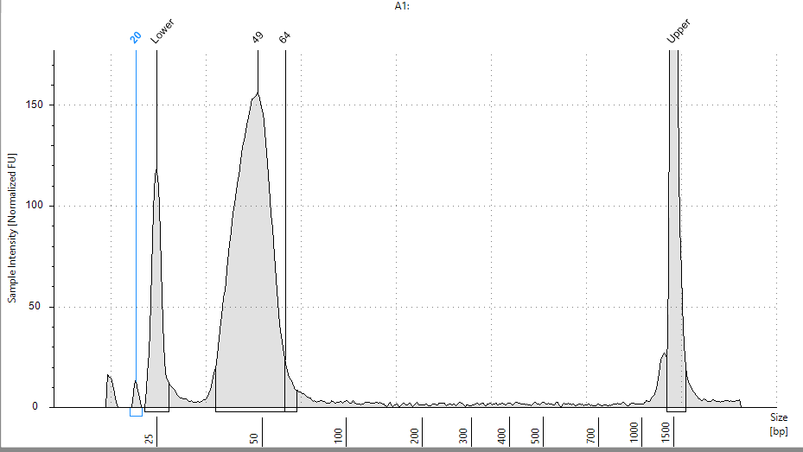
Genotyping of C9orf72 hexanucleotide repeats

Slide 3
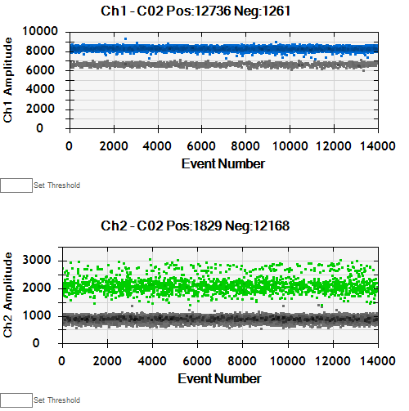
Cut-only initial DNA concentration
Initial DNA of 250 ng for Cut-only.
Good separation of FAM (Telomeres) and HEX (646 Single copy gene)

